Slide 1
The Smart Switch

Slide 2
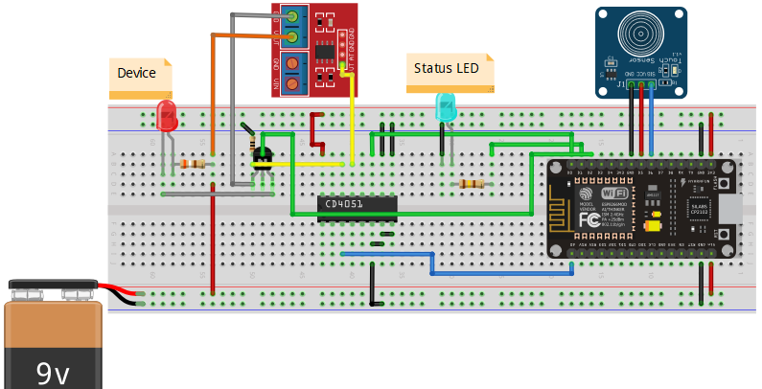
Design

Slide 3
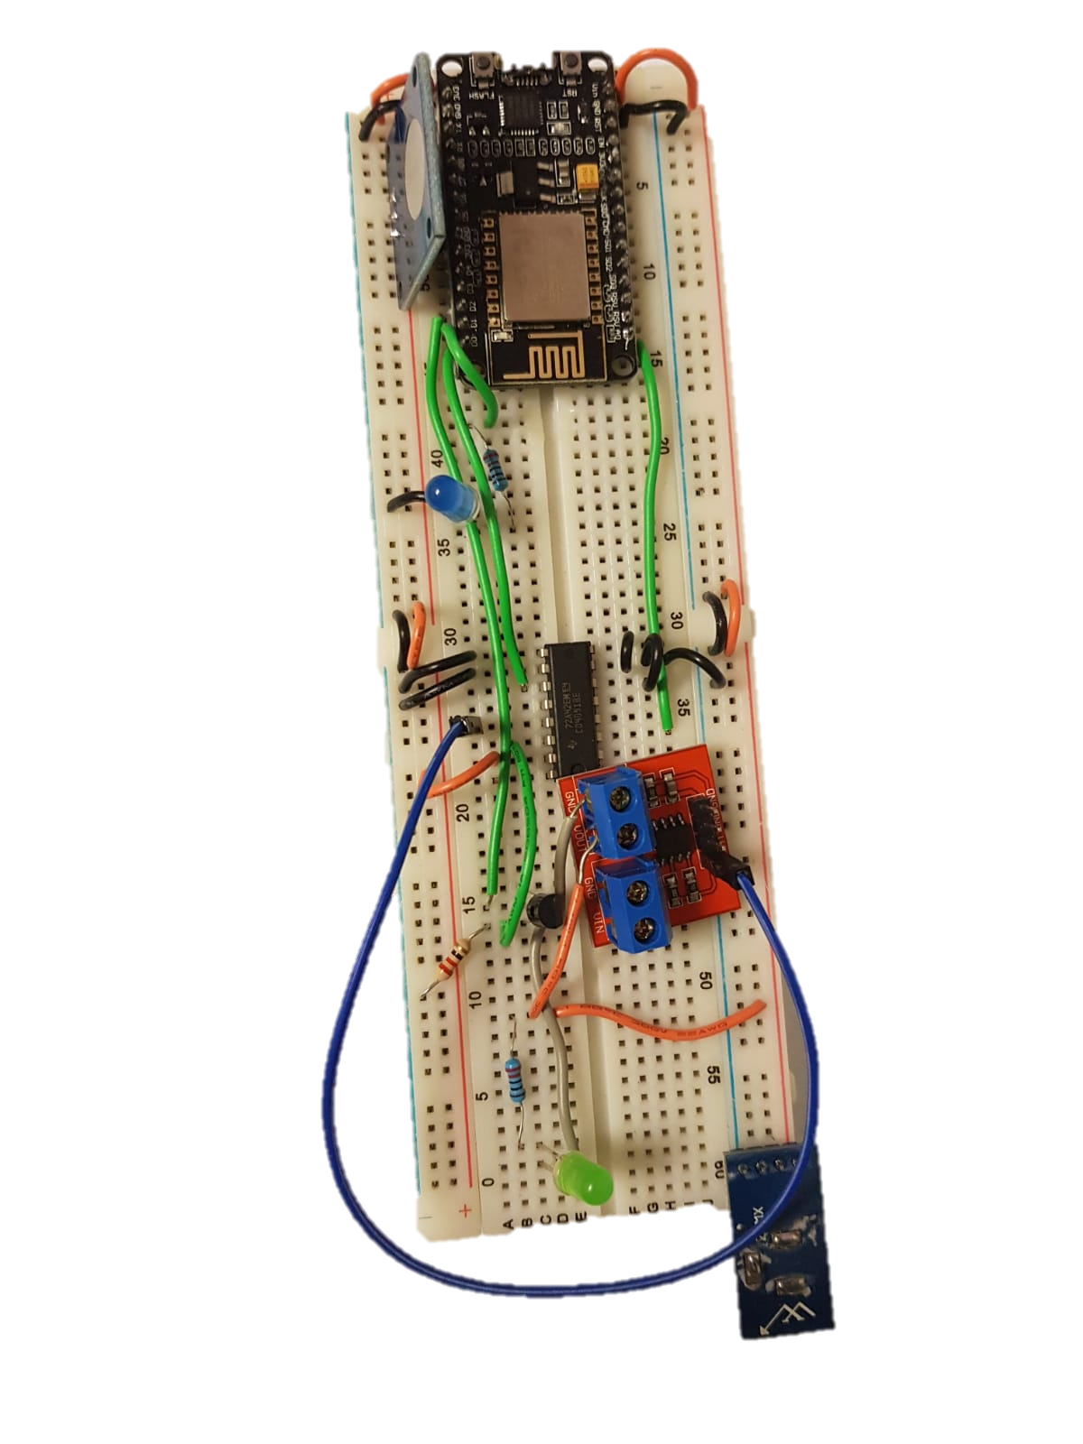
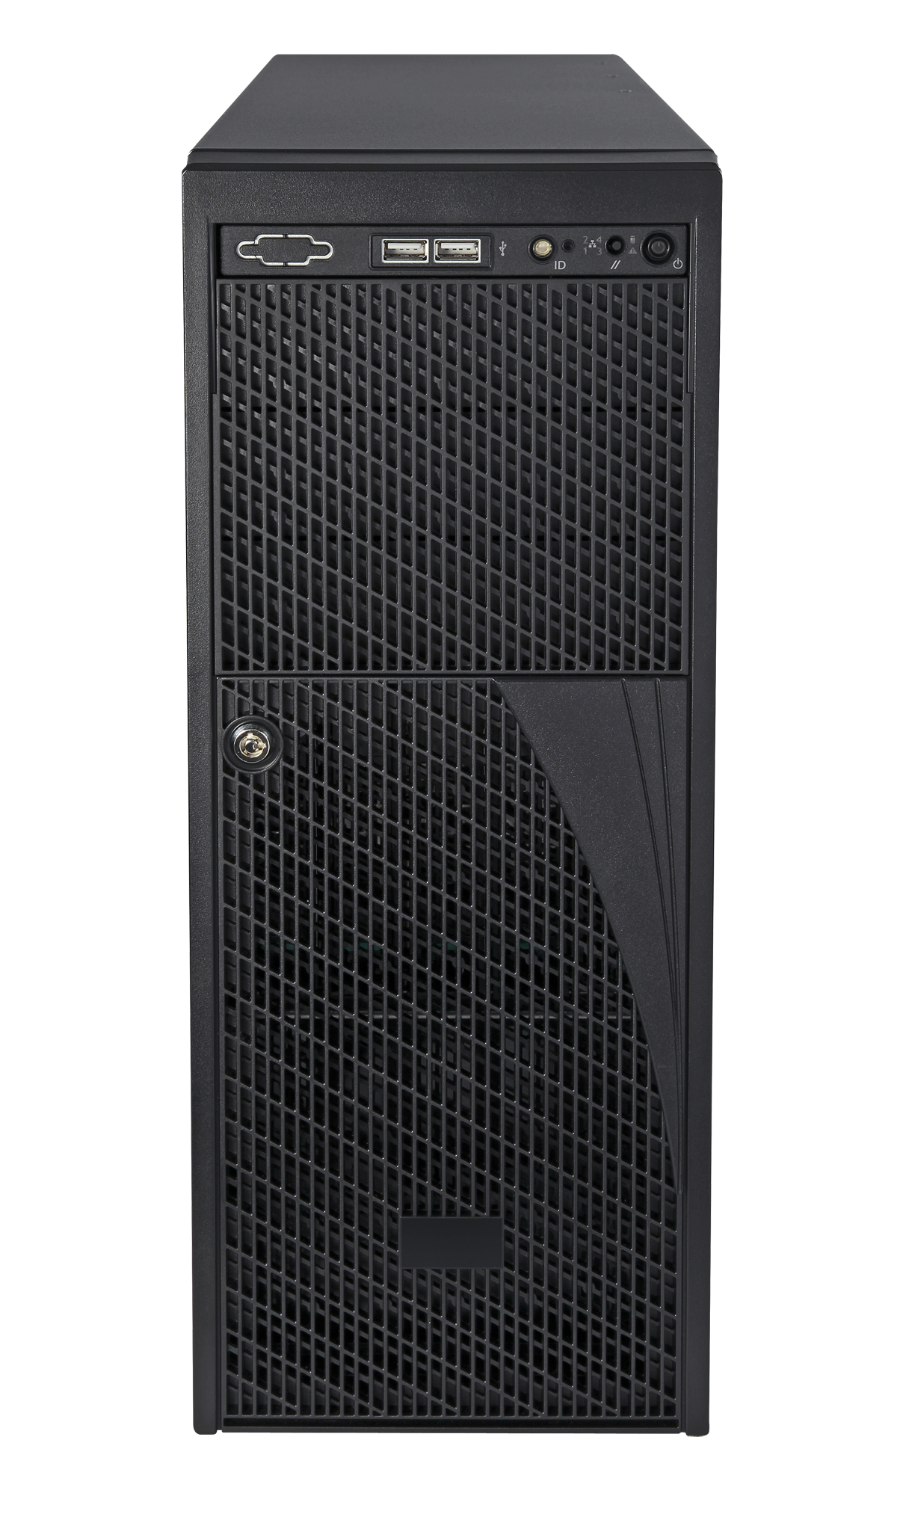
Server Communication
Websockets

Slide 4
Web API

Slide 5
ASP.NET Core RESTful API
Easily recognizable per REST standards
Uses DTOs for efficient data transmission
Numbered errors for efficient error handling
Plugs
Turn on/off
Change properties
Samples
Get samples of a given plug during a specified period
Tasks
Schedule periodic/single tasks (e.g. turn off in 5 minutes, turn on every morning)
A well-documented JavaScript API was built

